Slide 1

Maze Generation
By Elliott Thorley

Slide 2
What is the Purpose?
Demonstrate how parallel computing can effects the efficiency of a program
Visually represent how parallel computing works, as you will be able to see what each thread generated in a different color

Slide 3
Maze Generation Algorithms
• Randomized depth-first search
• Randomized Kruskal’s algorithm
• Randomized Prim’s algorithm
• Wilson’s algorithm
• Aldous-boarder algorithm
• Recursive division method
• Recursive backtracking

Slide 4
Recursive Backtracking
1. Choose a starting point
2. Randomly choose a wall at that point and carve a passage through to the adjacent cell, but only if the adjacent cell has not been visited yet. This becomes the new current cell
3. If all adjacent cells have been visited, back up to the last cell that has uncarved walls and repeat.
4. The algorithm ends when the process has backed all the way up to the starting point.

Slide 6
How Will it Work in Parallel?
Rather than generating many parts of the maze at once, generate many mazes at once that will connect
Connect the multiple mazes vertically rather than in a grid like the recursive division method
Rather than re-writing how the maze is generated, connect them by mirroring every other maze across the y-axis

Slide 7


Maze 1
Maze 2
Combine
Flip

Slide 8

A Maze With 3 Threads:

Slide 9
Side Effects of This Method
Because of how the start and end points line up, it creates a snake pattern throughout the maze
This is not necessarily a bad thing, as it makes the correct path use the entire width of the maze, without this it often gets stuck on the right edge
This can be demonstrated using 1 thread

Slide 10
How Will We Test it?
Time
Time the generation portion of each thread individually and then add it up on thread 0
Test
Test using different amounts of threads making different sized mazes
Graph
Calculate and plot speedup and efficiency

Slide 11
Raw Data:
Averaged Data:
N size | Threads | 1 | 5 | 10 | 20 | 50 | 100 | 200
10000 | Test 1 | 411 | 9396 | 19603
 | Test 2 | 403 | 10780 | 24964
 | Test 3 | 409 | 8661 | 22108
20000 | Test 1 | 781 | 17393 | 49687 | 60234
 | Test 2 | 764 | 16374 | 50097 | 55090
 | Test 3 | 768 | 12254 | 46852 | 67081
50000 | Test 1 | 1806 | 48089 | 114602 | 161788 | 113083
 | Test 2 | 1801 | 45999 | 113403 | 157226 | 112197
 | Test 3 | 1810 | 45503 | 114491 | 126771 | 122446
100000 | Test 1 | 3563 | 127235 | 205486 | 276354 | 263765 | 262480
 | Test 2 | 3555 | 134913 | 220433 | 306236 | 261170 | 315973
 | Test 3 | 3513 | 130352 | 215883 | 283289 | 330963 | 223589
500000 | Test 1 | 17258 | 695447 | 1356693 | 1795794 | 1571214 | 1415254 | 1103605
 | Test 2 | 17268 | 689555 | 1277202 | 1770560 | 733613 | 1824070 | 694697
 | Test 3 | 17232 | 667530 | 1374768 | 1748918 | 1843546 | 1642150 | 853363
10000000 | Test 1 | 34408 | 1363047 | 2951913 | 3712689 | 3737632 | 3328506 | 2164343
 | Test 2 | 34634 | 1365523 | 2658286 | 3258293 | 3599048 | 2874710 | 2620223
 | Test 3 | 34326 | 1347777 | 2580397 | 3324736 | 3585532 | 3108673 | 2386798
Threads | 1 | 5 | 10 | 20 | 50 | 100 | 200
NSize
10000 | 407.6666667 | 9612.333333 | 22225
20000 | 771 | 15340.33333 | 48878.66667 | 60801.66667
50000 | 1805.666667 | 46530.33333 | 114165.3333 | 148595 | 115908.6667
100000 | 3543.666667 | 130833.3333 | 213934 | 288626.3333 | 285299.3333 | 267347.3333
500000 | 17252.66667 | 684177.3333 | 1336221 | 1771757.333 | 1382791 | 1627158 | 883888.3333
10000000 | 34456 | 1358782.333 | 2730198.667 | 3431906 | 3640737.333 | 3103963 | 2390454.667

Slide 12
Speedup Data:
Efficiency Data:
Threads | 5 | 10 | 20 | 50 | 100 | 200
NSize
10000 | 0.04241079169 | 0.01834270716
20000 | 0.05025966407 | 0.01577375269 | 0.01268057345
50000 | 0.03880622676 | 0.01581624311 | 0.01215159774 | 0.01557835767
100000 | 0.02708535032 | 0.01656429865 | 0.012277697 | 0.01242087258 | 0.01325491682
500000 | 0.02521665923 | 0.01291153684 | 0.009737601387 | 0.0124766987 | 0.01060294493 | 0.01951905689
10000000 | 0.02535799823 | 0.01262032702 | 0.01003990203 | 0.009464016996 | 0.01110064778 | 0.01441399433
Threads | 5 | 10 | 20 | 50 | 100 | 200
NSize
10000 | 0.008482158338 | 0.001834270716
20000 | 0.01005193281 | 0.001577375269 | 0.0006340286725
50000 | 0.007761245352 | 0.001581624311 | 0.0006075798872 | 0.0003115671534
100000 | 0.005417070064 | 0.001656429865 | 0.00061388485 | 0.0002484174516 | 0.0001325491682
500000 | 0.005043331846 | 0.001291153684 | 0.0004868800694 | 0.0002495339739 | 0.0001060294493 | 0.00009759528447
10000000 | 0.005071599645 | 0.001262032702 | 0.0005019951013 | 0.0001892803399 | 0.0001110064778 | 0.00007206997163

Slide 13
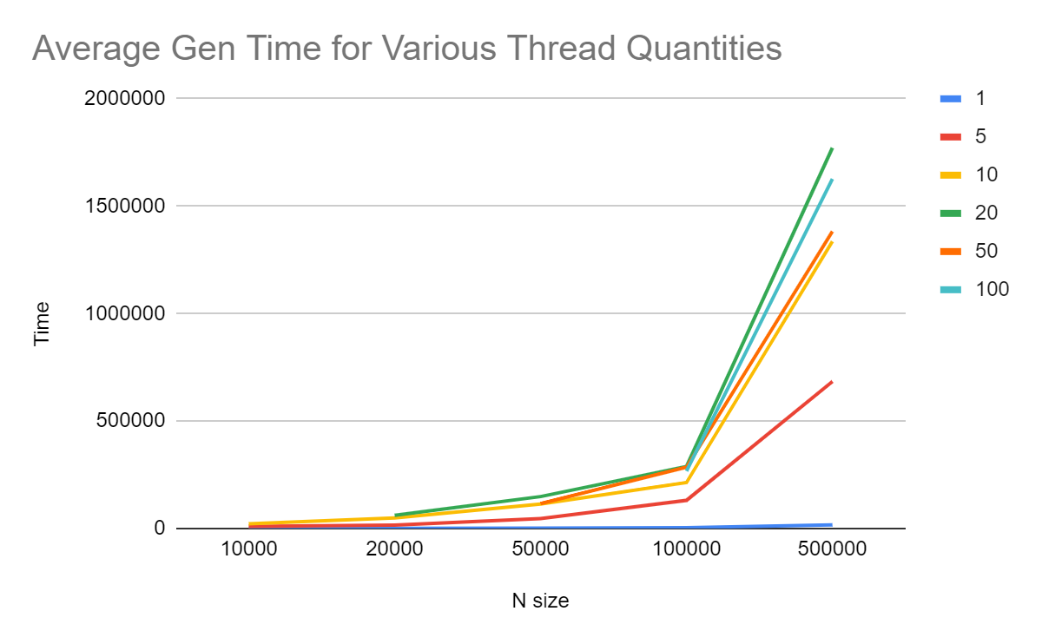
Visual Data:

